Slide 1
Big Mountain Resort
A inquiry to generate more revenue.

Slide 2
How can Big Mountain Resort generate more revenue valued by its customers or other means?
Discovering what customers want and building facilities to increase ‘attractiveness’ of the resort.
Taking a look at current resort operations and seeing what could be cut or improved.
Comparing Big Mountain among its competitors and making adjustments based on that information.

Slide 3
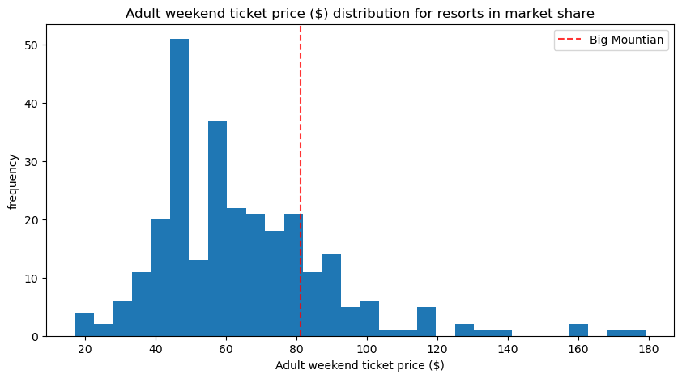
Big Mountain ticket prices market share in National context.
-Currently Big Mountain sits just slightly above average for ticket price compared to its market competitors. This could mean there is some room to generate more revenue through ticket price.

Slide 4
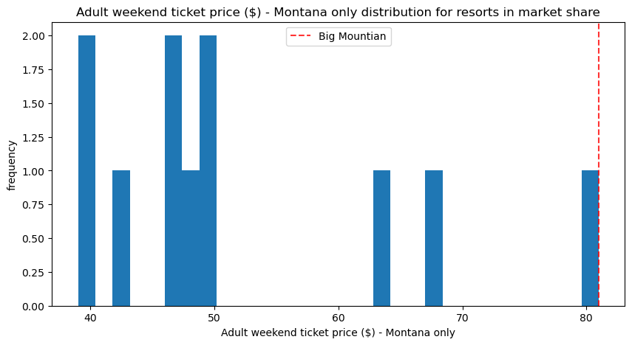
Big Mountain ticket prices market share in statewide context.
-Big Mountain ticket prices in a statewide market share currently charges a premium compared to its competitors.
-Determining what attractions and services are provided against competitors could provide insights to generating more revenue.

Slide 5
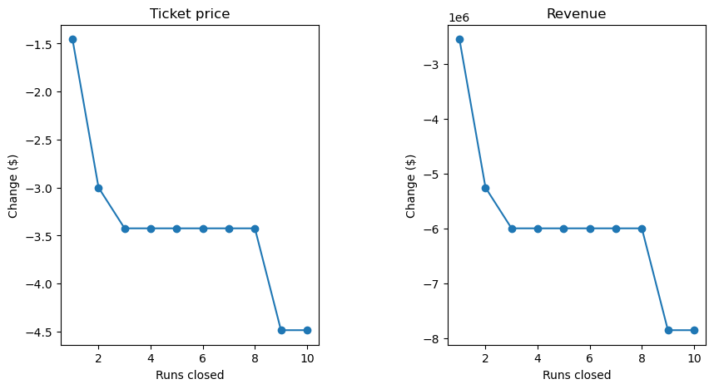
Available runs optimization.
The figures on the right show that closing a single run would have no meaningful impact on price. However closing more than two has a significant impact on park revenue. Closing more than eight would see drastic impact on revenue.
-Closing down of one of the parks least profitable or attractive runs to expand on other more attractive runs could lead to increased profits.

Slide 6
Big Mountain Resort optimization.
-Increasing in vertical drop by 150 ft, adding a additional run and add 1 more chair lift
This scenario increases support for ticket price by $1.36
Over the season, this could be expected to amount to 2,386,364$.
-Adding 2 more acres of snow making capabilities with facility expansion mentioned above.
This scenario shows no meaningful increase in revenue.
- Increasing the longest run by .2 miles and adding 4 acres of snow making facilities.
This scenario showed no increase in potential revenue.
-Currently Big Mountain Resort charges 81$ for adult weekend ticket.
Model suggested ticket price based on market competition is 104.03$. That is an additional 23% increase in revenue.

Slide 7
Conclusion
-Big Mountain sits just above average on ticket price national. However in terms of state it charges a premium price compared to its competitors.
-Closing down more than one run would see significant loss in potential revenue.
-Increasing the longest run, adding 1 more chair lift and increasing snow making capabilities by 2 acres could generate 2,386,364$ in additional revenue.
-In context of ticket price compared to competitors Big mountain could charge up to 104.03 based on its current facilities.

